Slide 1
Instruction to SMPL and MANO
Jikai Wang

Slide 2
Basic Concepts

Slide 3
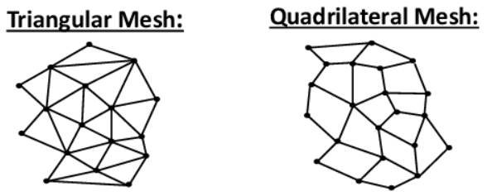
Basic Concepts
Vertex
Position: 3D coordinate in space (x, y, z).
Color: the color information (r, g, b).
UV coordinate: used for texture mapping of the surface.
Normal Vector: used for lighting calculation, displacement mapping, etc.
Skinning Weights: weighting for assignment to bones to control animation
Rigging
Mesh: a surface to represent the character (triangle mesh, quad mesh, etc.).
Bone (Skeleton): a hierarchical set of interconnected parts, which is a virtual representation used to animate the mesh.
one bone is associated with a group of vertices
one vertex could be assigned to multiple bones together with skinning weights
Skinning Function: deform the mesh according to bones
Simple Skinning
Linear Blend Skinning (LBS)
Dual Quaternion Blend Skinning (DQBS)

Slide 4
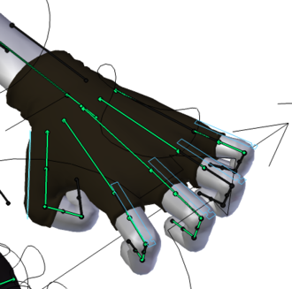
Example of Rigging
Bones (in green) are used to pose a hand, they are virtual/invisible.
By skinning function, we only need to pose the bones, and the mesh will be deformed accordingly.

Slide 5
SMPL: Skinned Multi-Person Linear Model

Slide 6
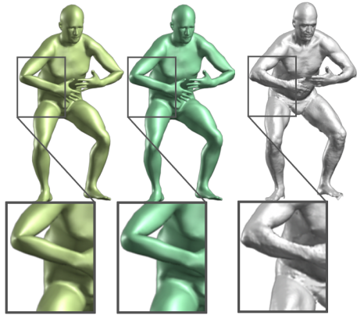
Why SMPL?
Traditional methods just model the relationship between vertices and underlying skeleton structure.
They may produce unrealistic deformations at joints.
Need a realistic model representing human in different poses.
LBS
DQBS
GT

Slide 7
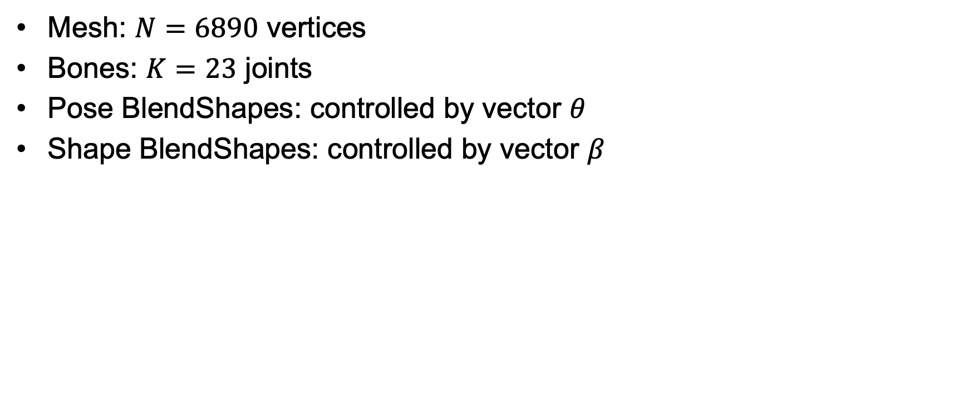
SMPL Model
Mesh: $N=\text{6890}$ vertices
Bones: $K=23$ joints
Pose BlendShapes: controlled by vector $θ$
Shape BlendShapes: controlled by vector $β$

Slide 8
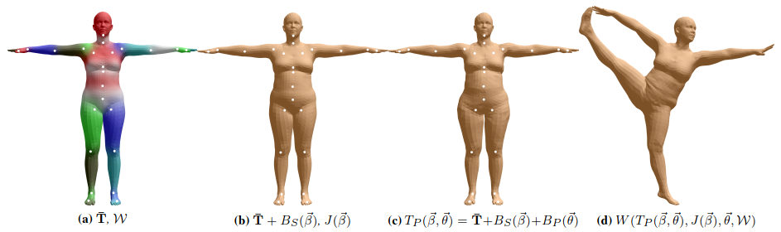
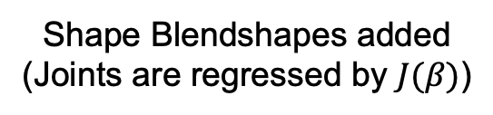
SMPL Model
Template in T-pose
Shape Blendshapes added
(Joints are regressed by $J(β)$)
Shape Blendshapes are added
Deform Mesh by Skinning Function

Slide 9
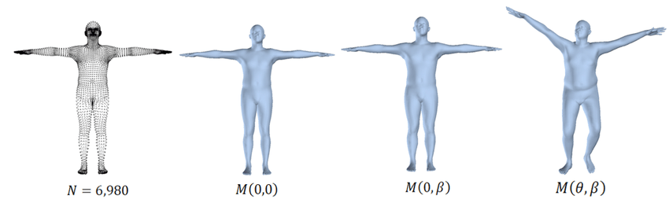
SMPL Model

Slide 10
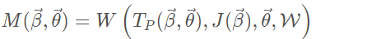
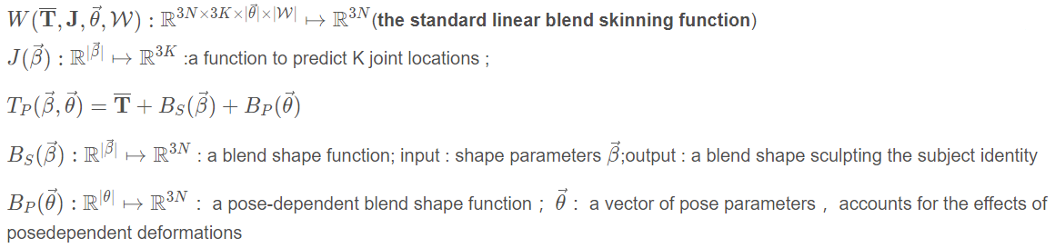
SMPL - Functions

Slide 11
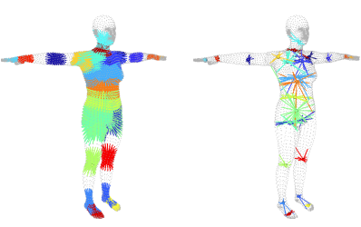
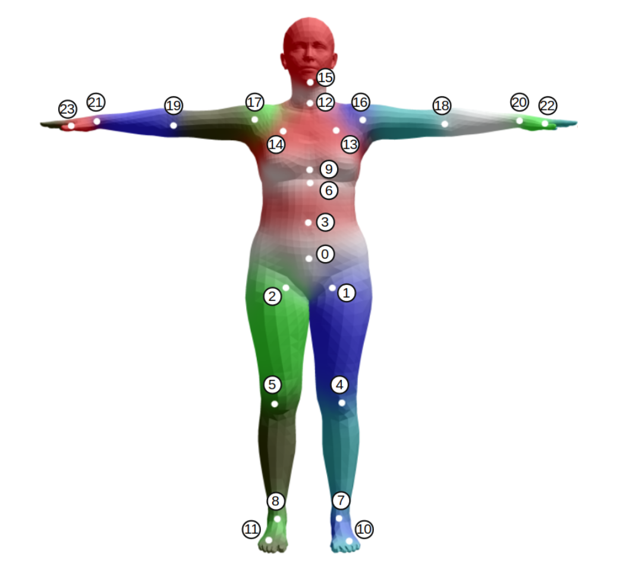

SMPL – Joint Regressor $J(β)$
Initialization of Joints and Blend Weights
Joint Regression Function 𝐽(𝛽)

Slide 12
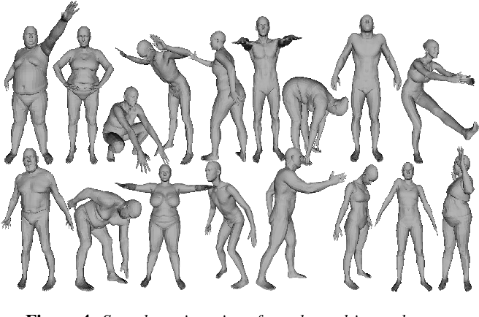
SMPL

Slide 13
SMPL-H (MANO)

Slide 14
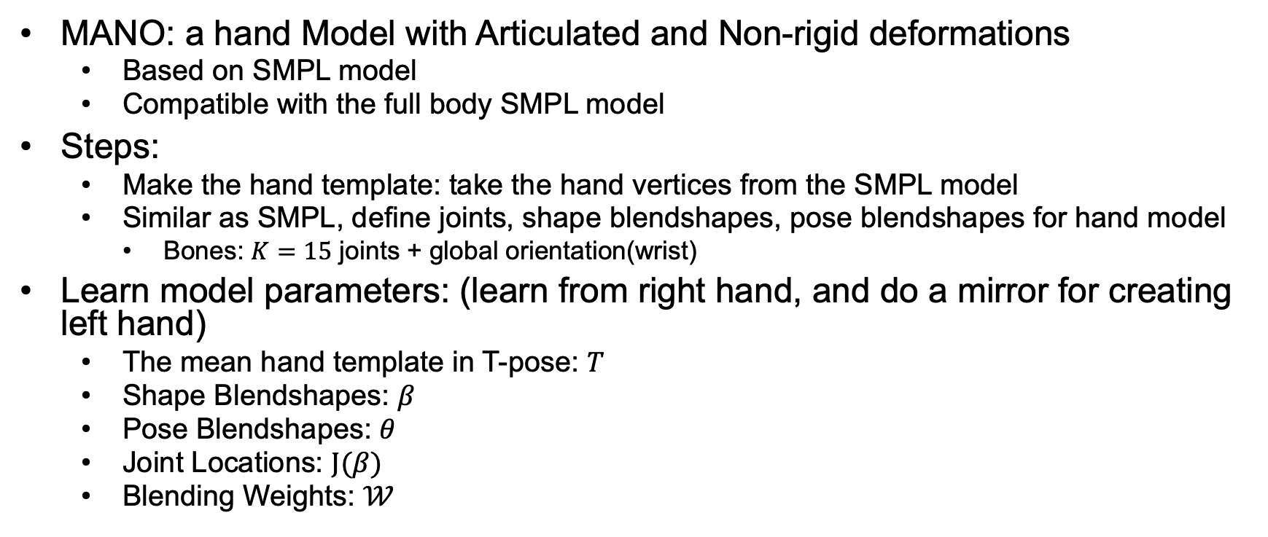
MANO
MANO: a hand Model with Articulated and Non-rigid deformations
Based on SMPL model
Compatible with the full body SMPL model
Steps:
Make the hand template: take the hand vertices from the SMPL model
Similar as SMPL, define joints, shape blendshapes, pose blendshapes for hand model
Bones: $K=15$ joints + global orientation(wrist)
Learn model parameters: (learn from right hand, and do a mirror for creating left hand)
The mean hand template in T-pose: $T$
Shape Blendshapes: $β$
Pose Blendshapes: $θ$
Joint Locations: $J(β)$
Blending Weights: $𝒲$

Slide 15
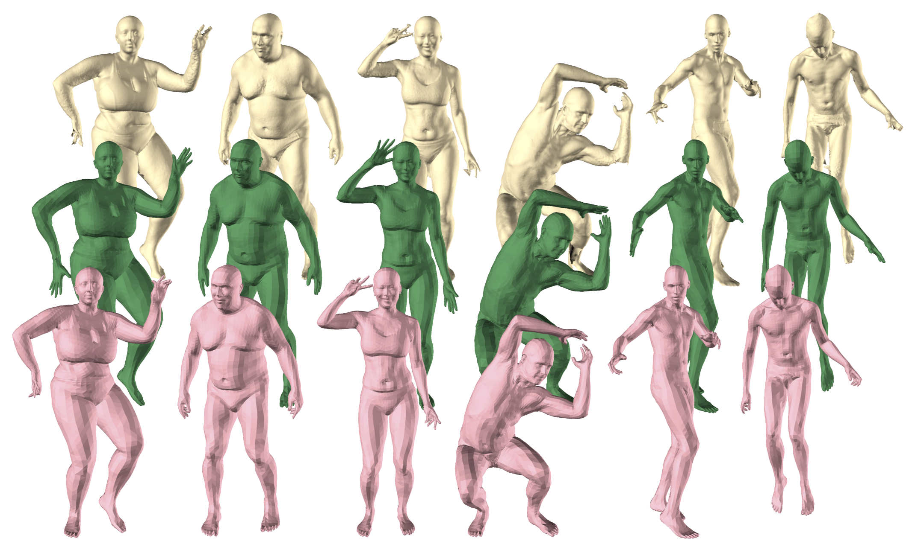
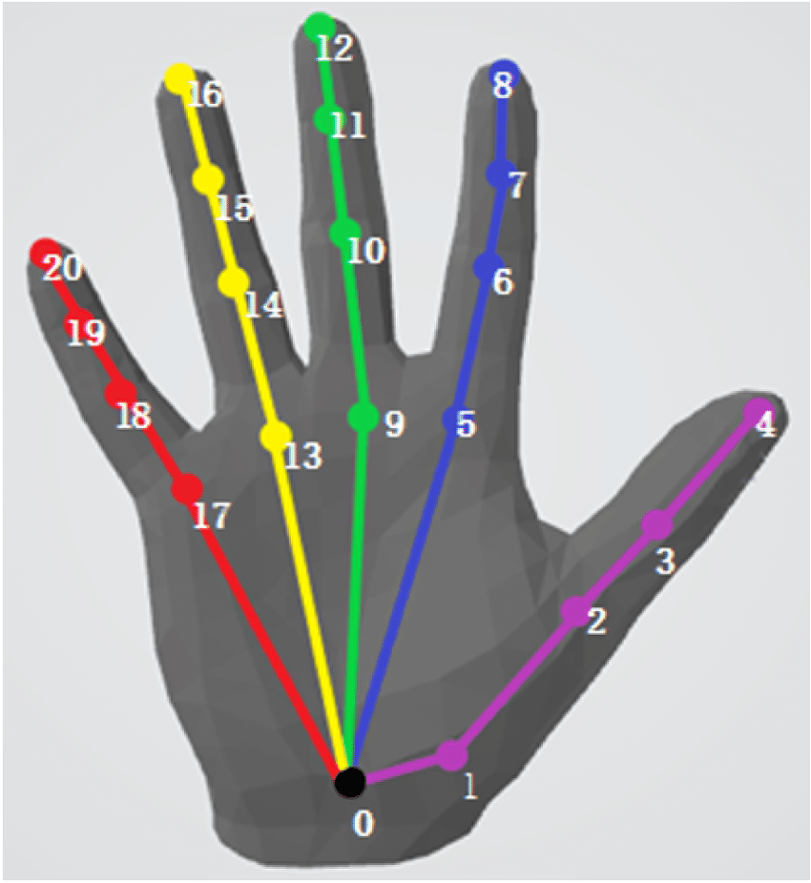
SMPL+H

Slide 16
SMPL-X

Slide 17
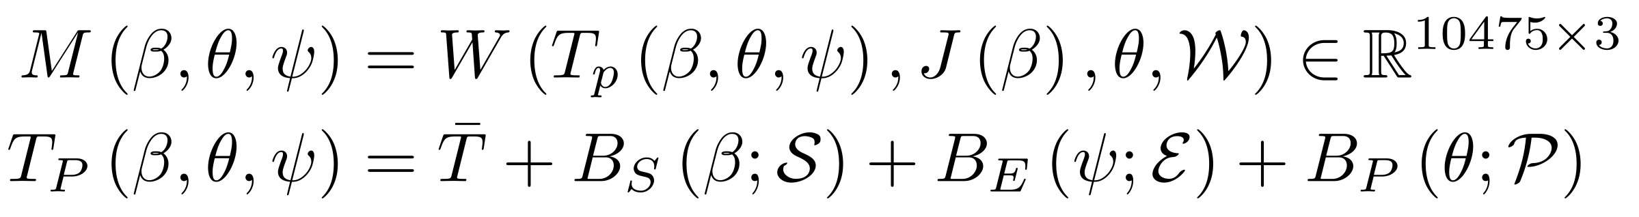
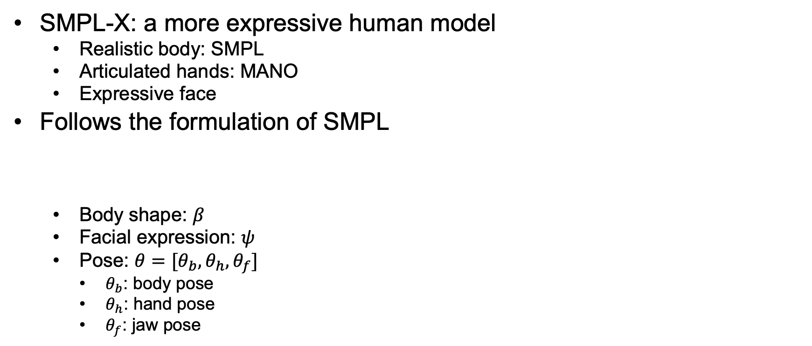
SMPL-X
SMPL-X: a more expressive human model
Realistic body: SMPL
Articulated hands: MANO
Expressive face
Follows the formulation of SMPL
Body shape: $β$
Facial expression: $ψ$
Pose: $θ=[θ_{b},θ_{h},θ_{f}]$
$θ_{b}$: body pose
$θ_{h}$: hand pose
$θ_{f}$: jaw pose

Slide 18
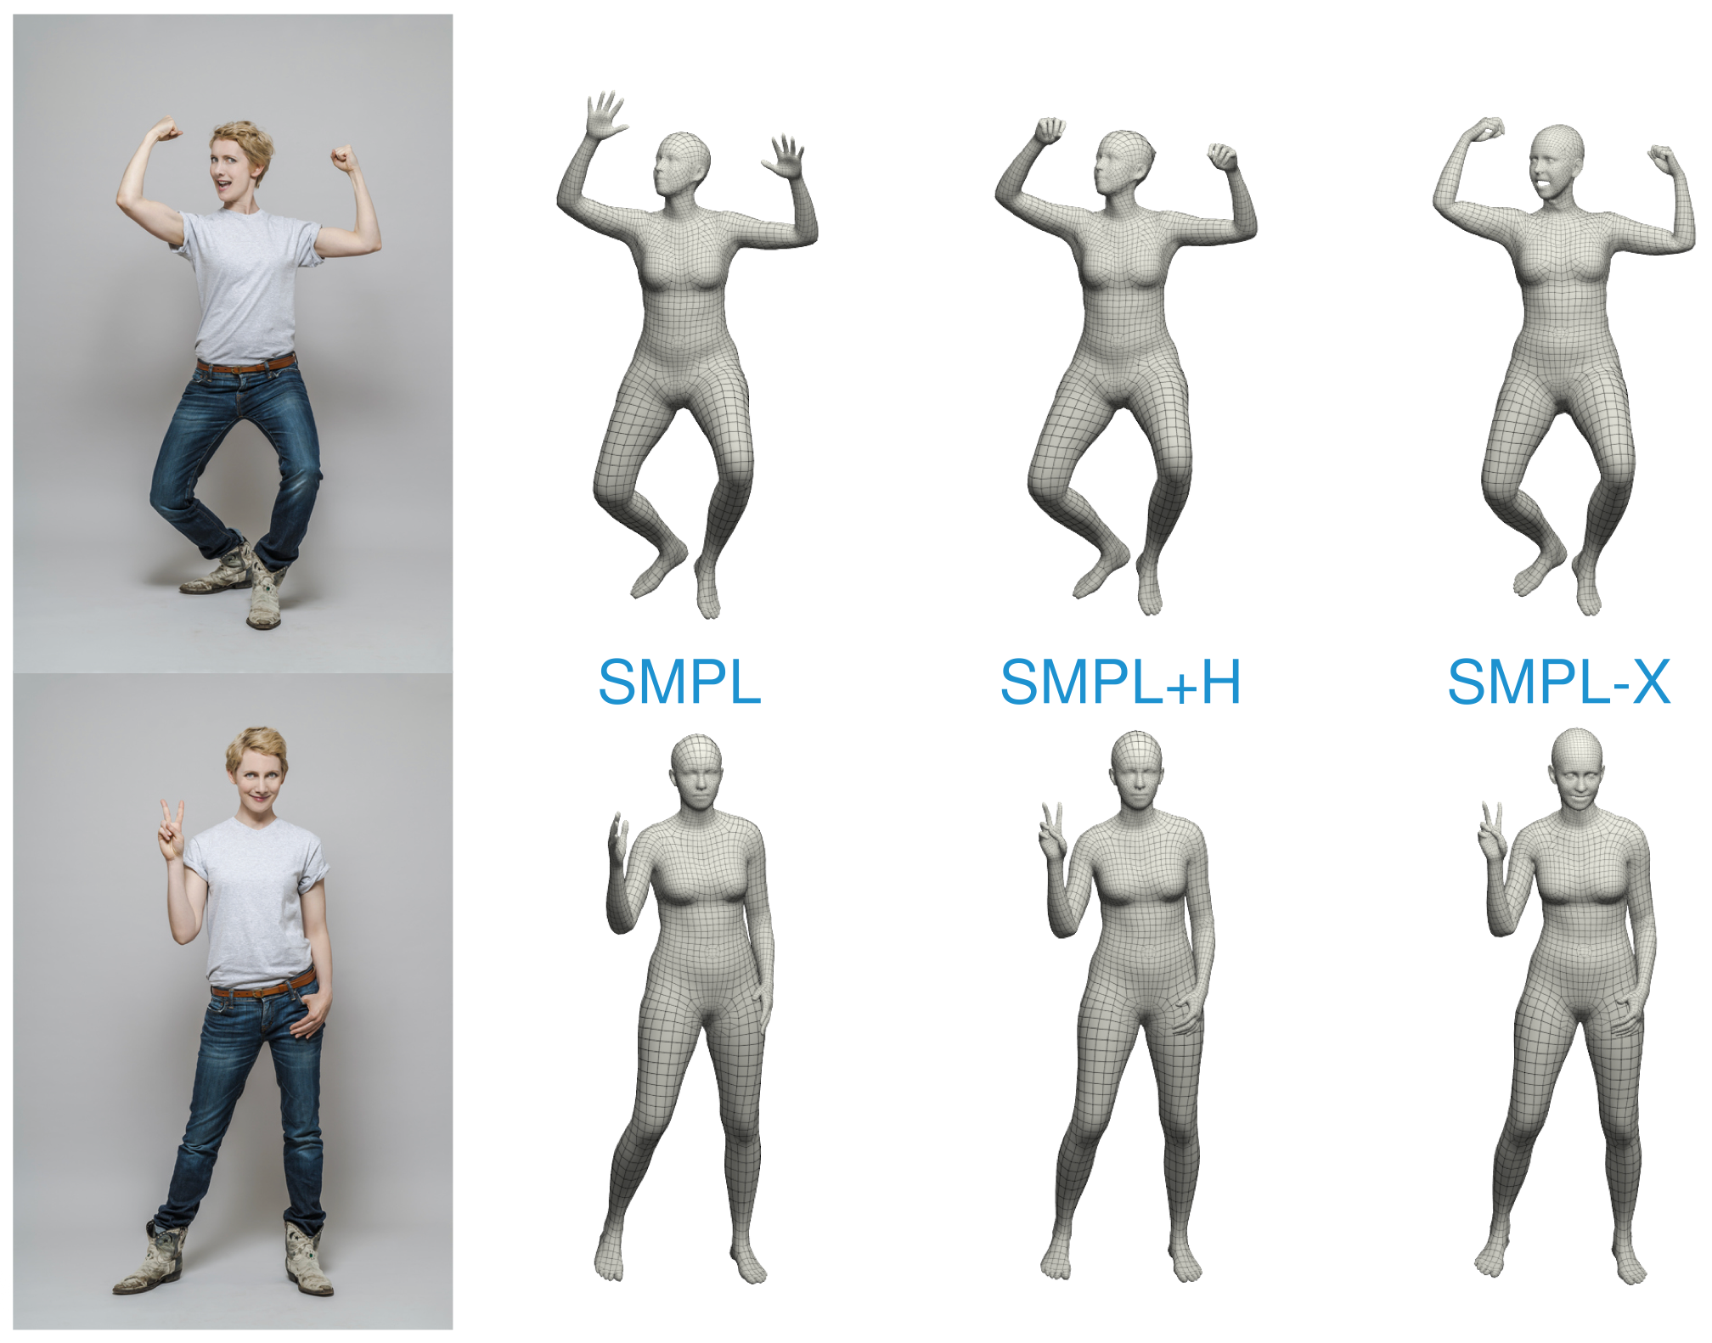

Slide 19
MANO Layer for PyTorch

Slide 20
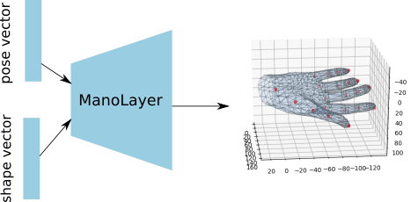
MANO Layer for PyTorch (manopth)
manopth
ManoLayer takes batched hand pose and shape vectors and outputs corresponding hand joints and vertices.

Slide 21
Resources
Websites
SMPL
SMPL-H
SMPL-X
manopth Github
manopth

